Slide 1
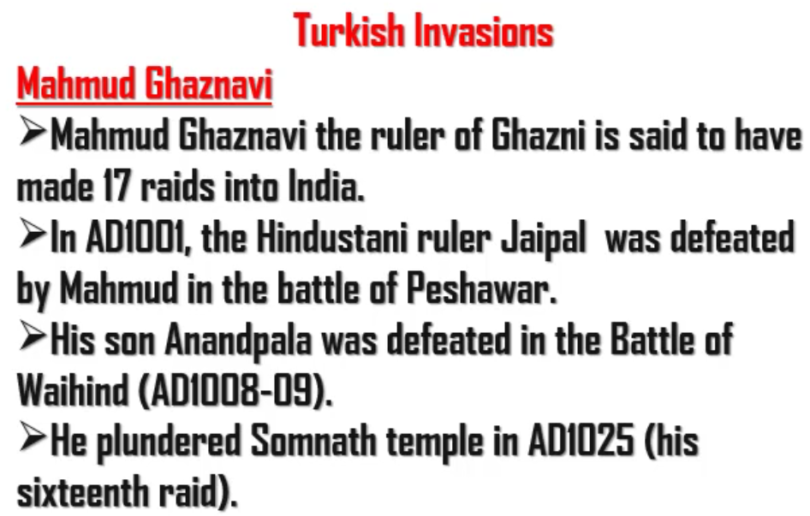
Jaipal was the father of Anandapal
Mahmud Ghaznavi defeated both:
Jaipal (In the battle of Peshawar)
Anandapal (In the battle of Waihind)

Slide 2
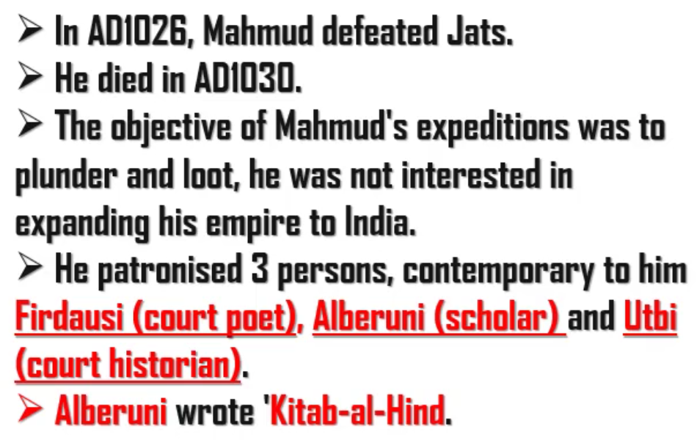
Mahmud was not interested in expanding his empire. Mahmud wanted to be Islamic hero. So, he only looted India. He did not expand his empire into India.

Slide 3
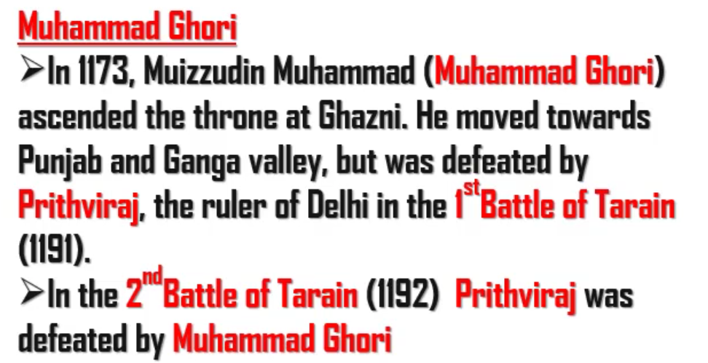
Muhammad Ghori is the uttaradhikari of Mahmud Ghaznavi
Prithvi here is Prithvi Raj Chauhan

Slide 4
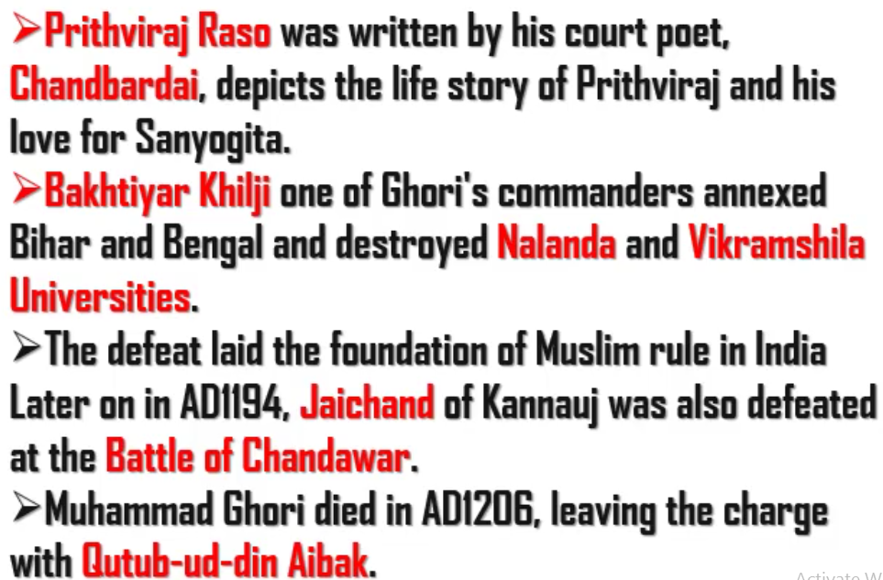
According to Prithviraj Raso, Jaichand was the father of Sanyogita. Sanyogita secretly married Jaichand against the wish of Jaichand. This led to the rivalry between Prithviraj Chauhan and Jaichand.
Due to this rivalry, Jaichand allied with Ghori and defeated Prithviraj Chauhan in the Second Battle of Tarain.
Few years later, the rivalry developed even between Ghori and Jaichand. They fought in the Battle of Chandawar where Jaichand was defeated by Ghori.
Jaichand was from Ghadwal dynasty and was ruling Kannauj.

